Slide 1

MIB
Final Presentation
Qifan Shi

Slide 2
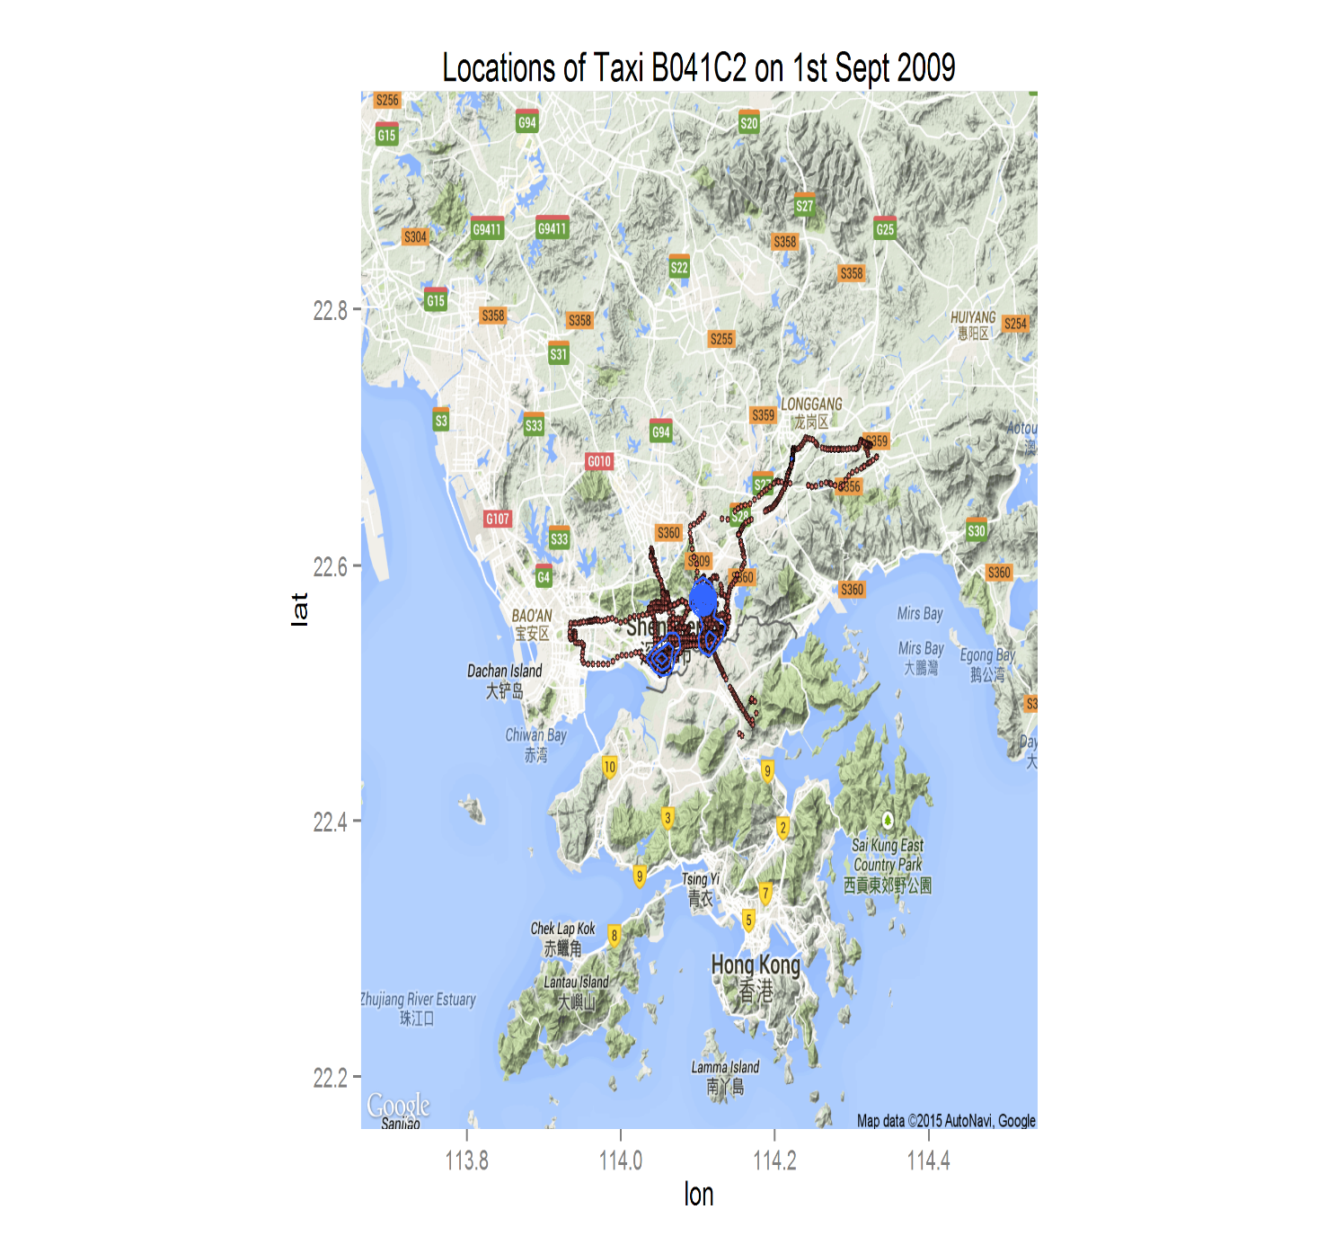
Here We Go!

Slide 3
Visualization
Questions
What is the entire taxi flow ?
How the flow varies hour by hour?
Business Value
Understand people’s behaviors
Catch up potential fare

Slide 4
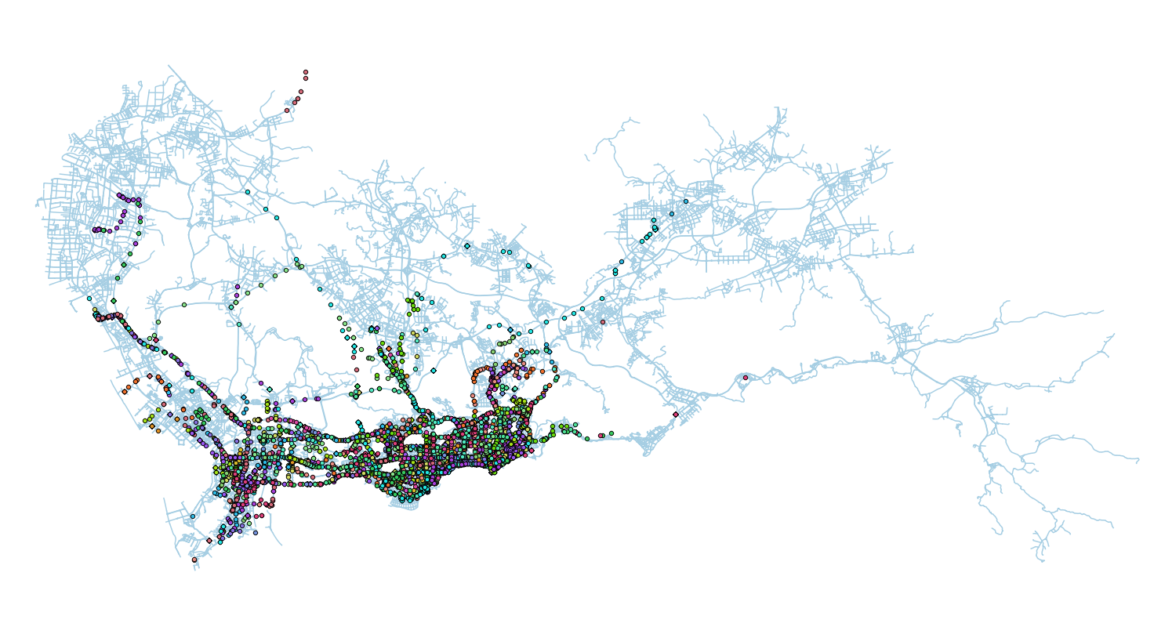
Entire Day of 09/08/2009

Slide 5
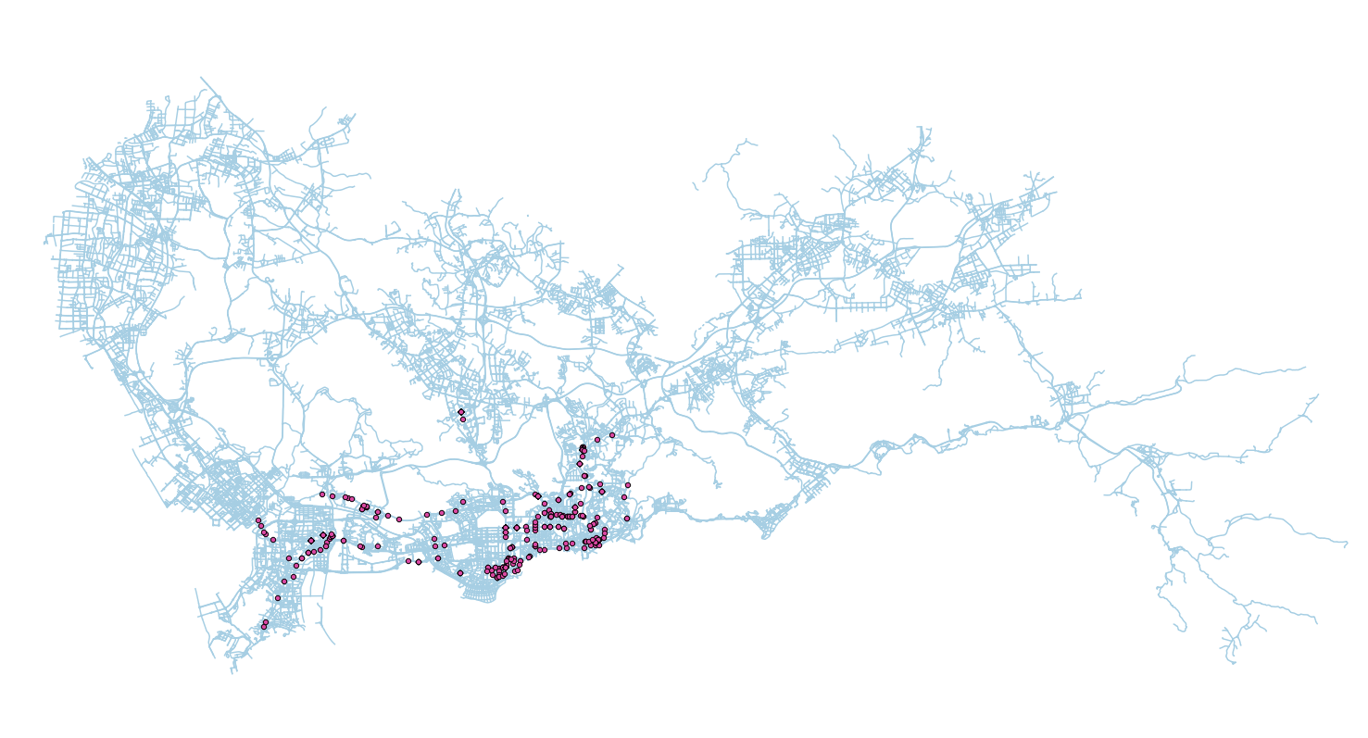
0 – 1 AM

Slide 6
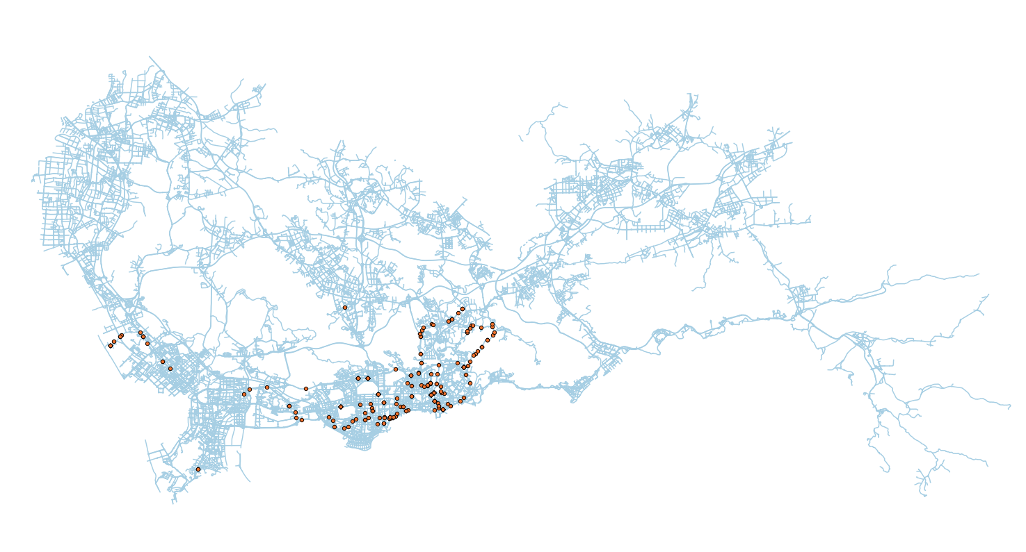
1 – 2 AM

Slide 7
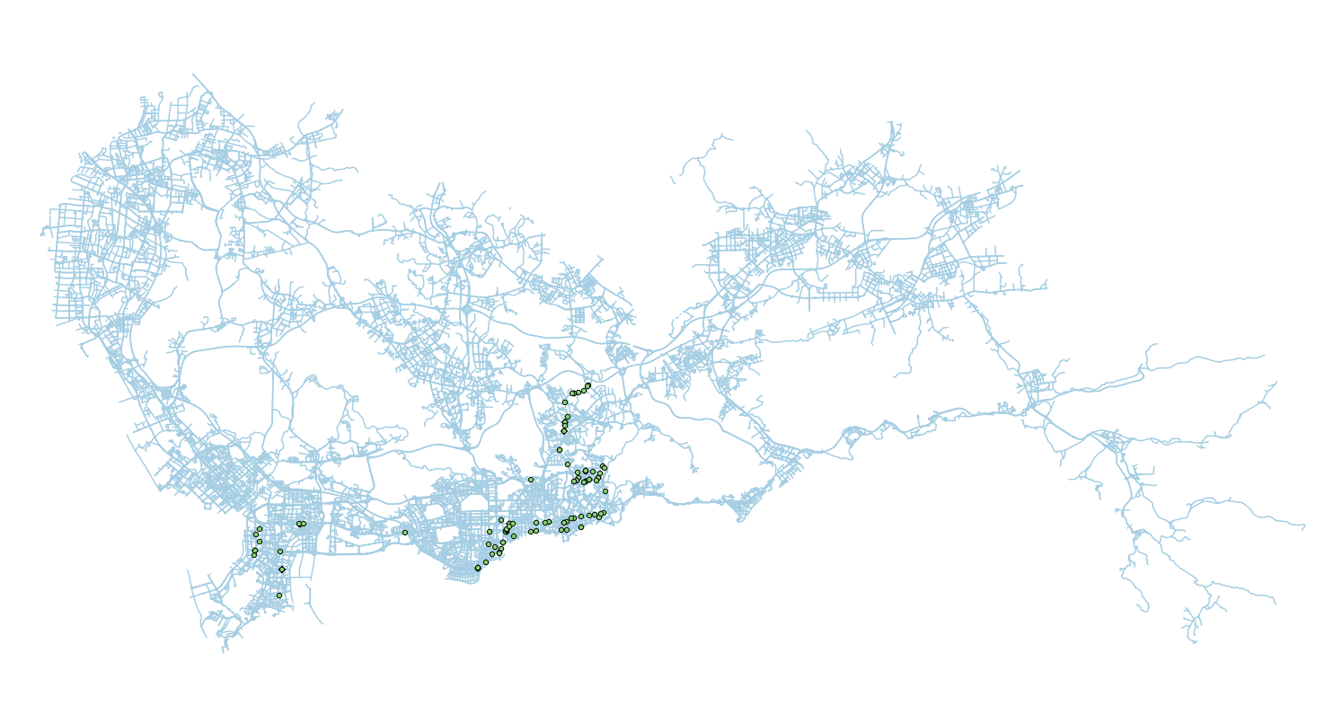
2 – 3 AM

Slide 8
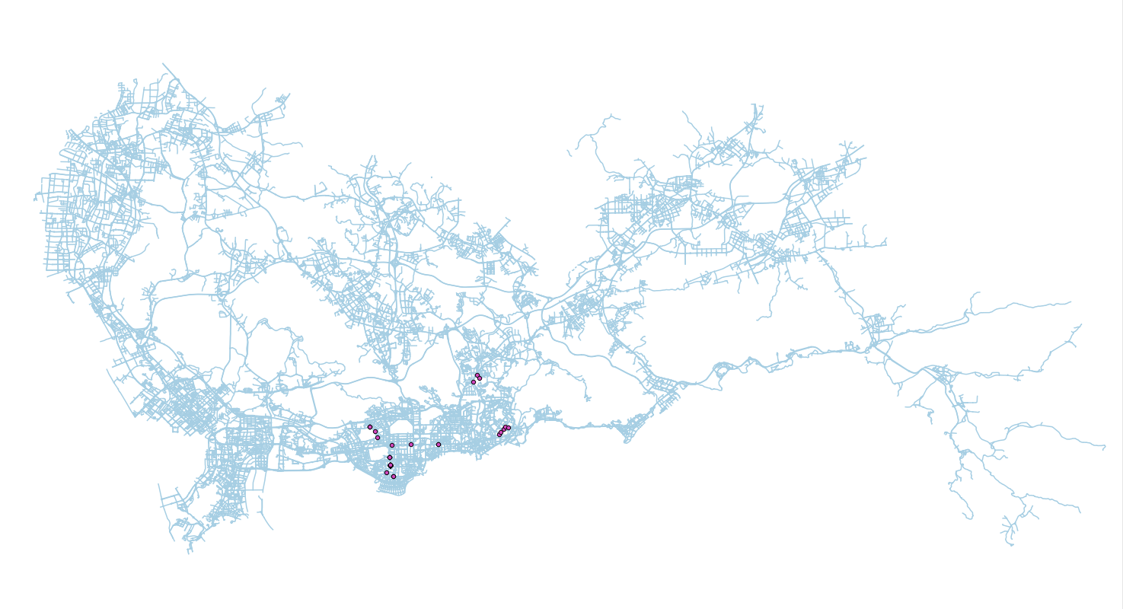
3 – 4 AM

Slide 9
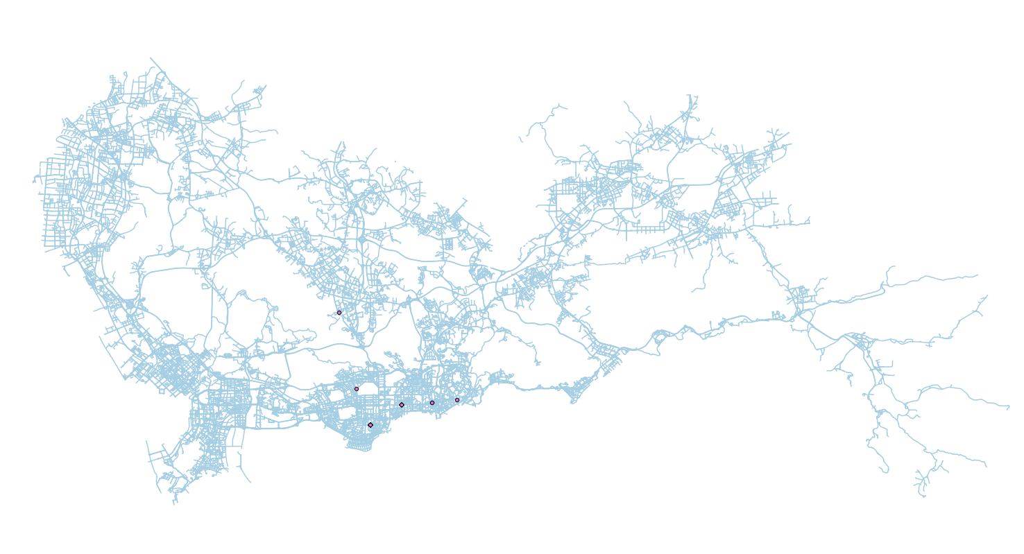
4 – 5 AM

Slide 10

5 – 6 AM

Slide 11

6 – 7 AM

Slide 12
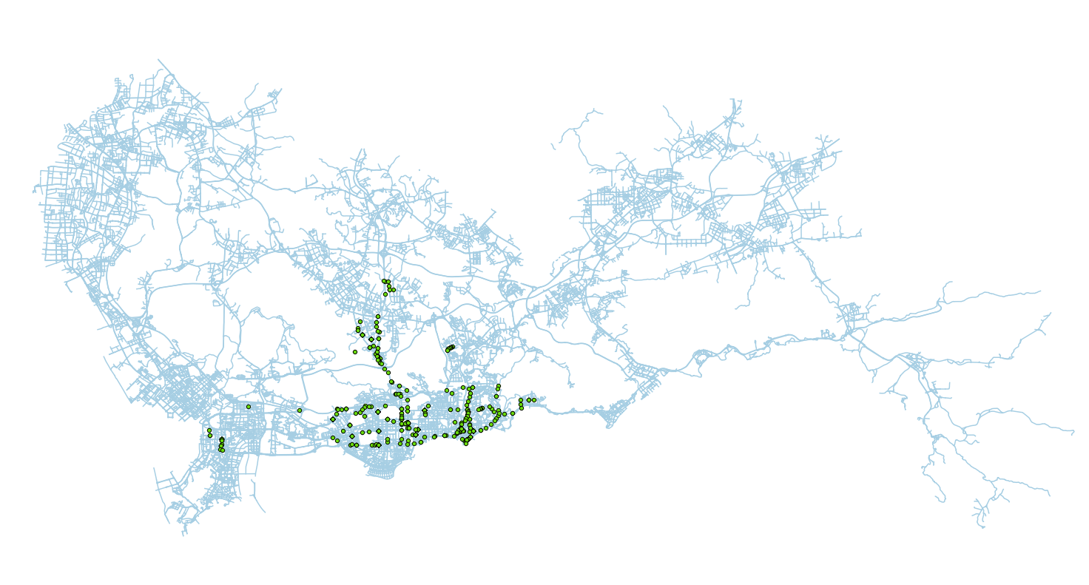
7 – 8 AM

Slide 13
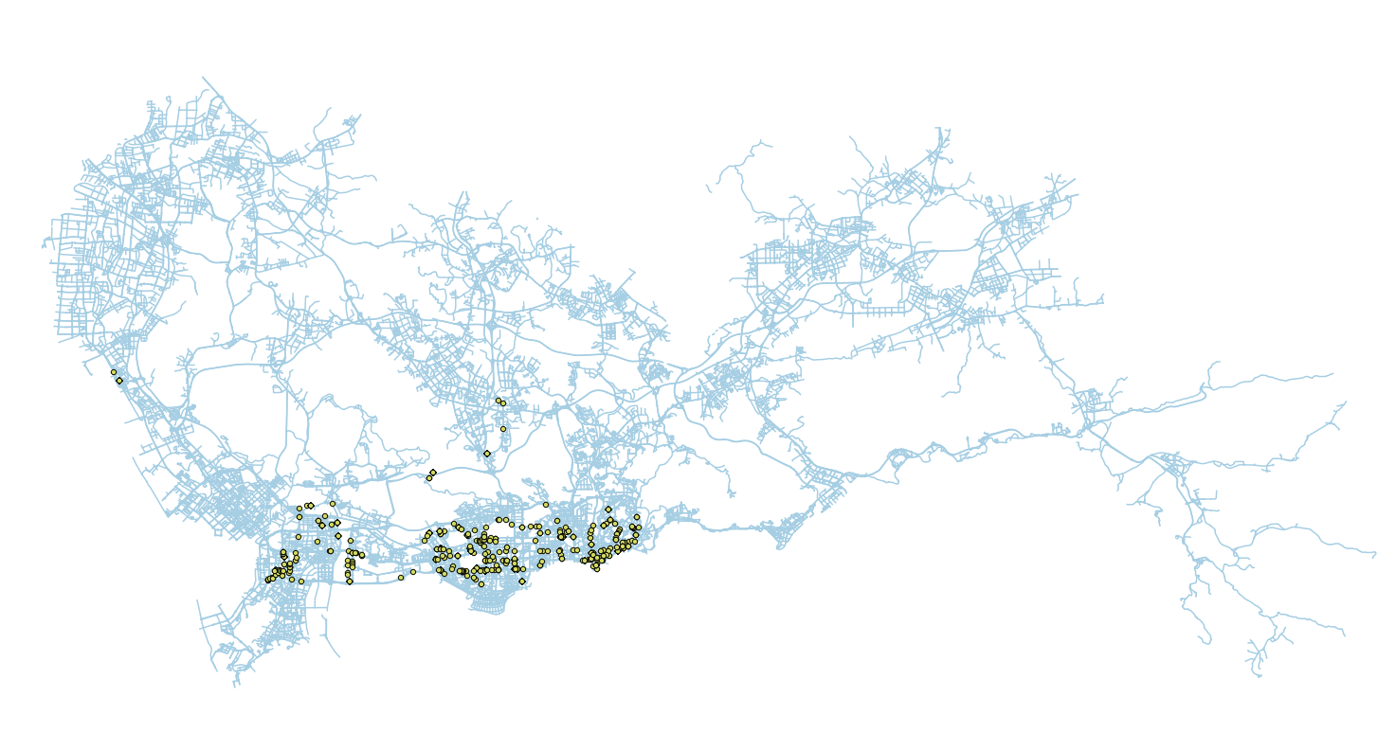
8 – 9 AM

Slide 14
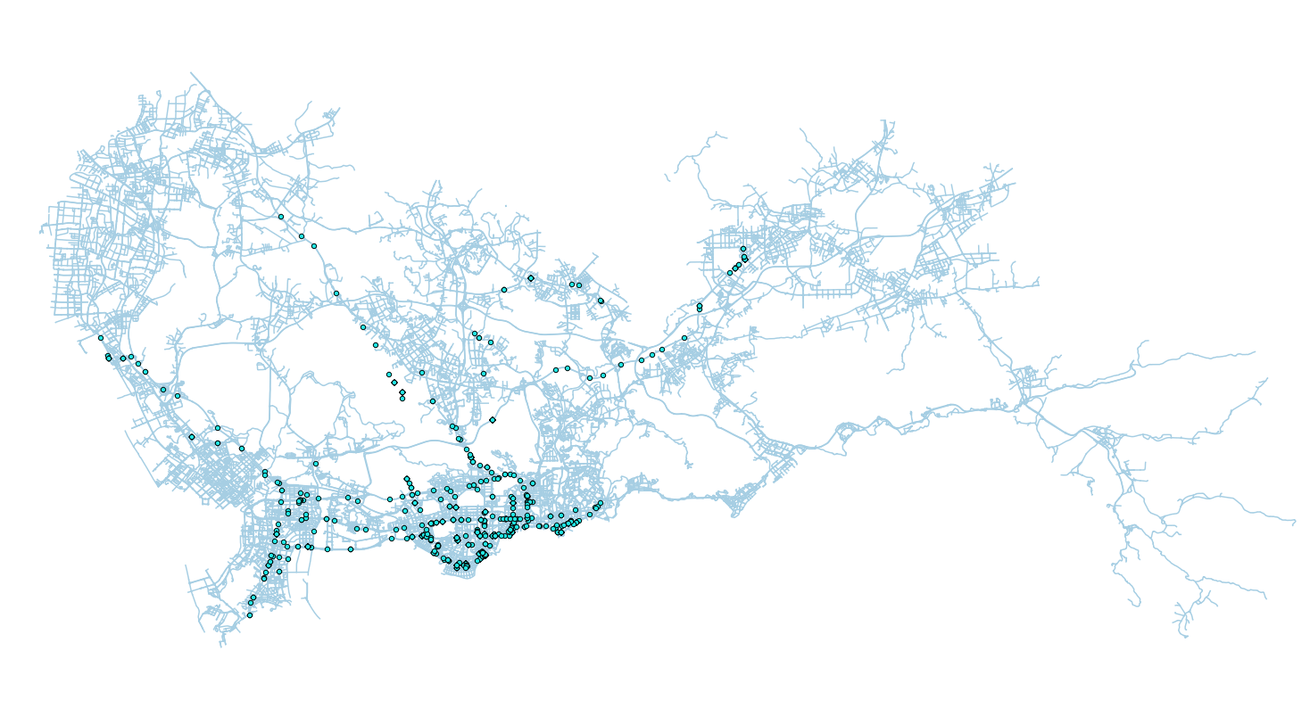
9 – 10 AM

Slide 15
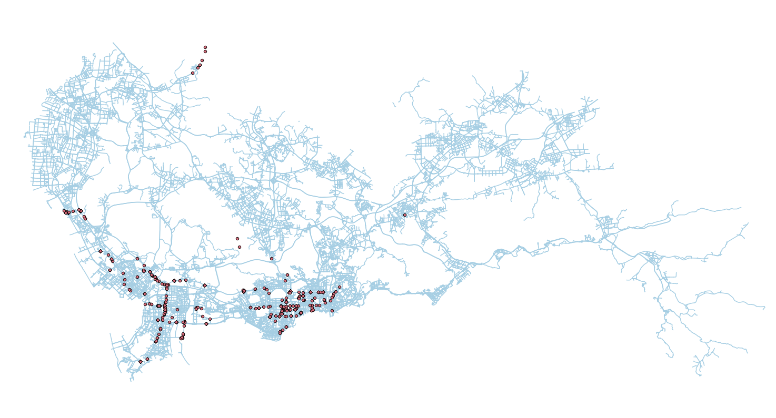
10 – 11 AM

Slide 16
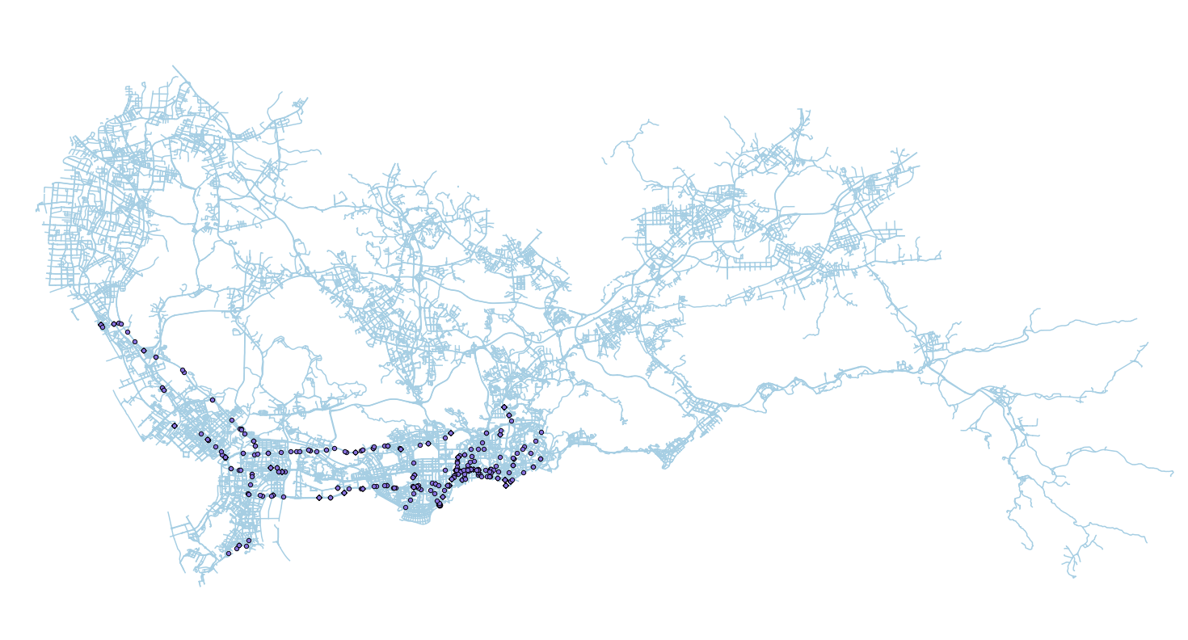
11 – 12 PM

Slide 17
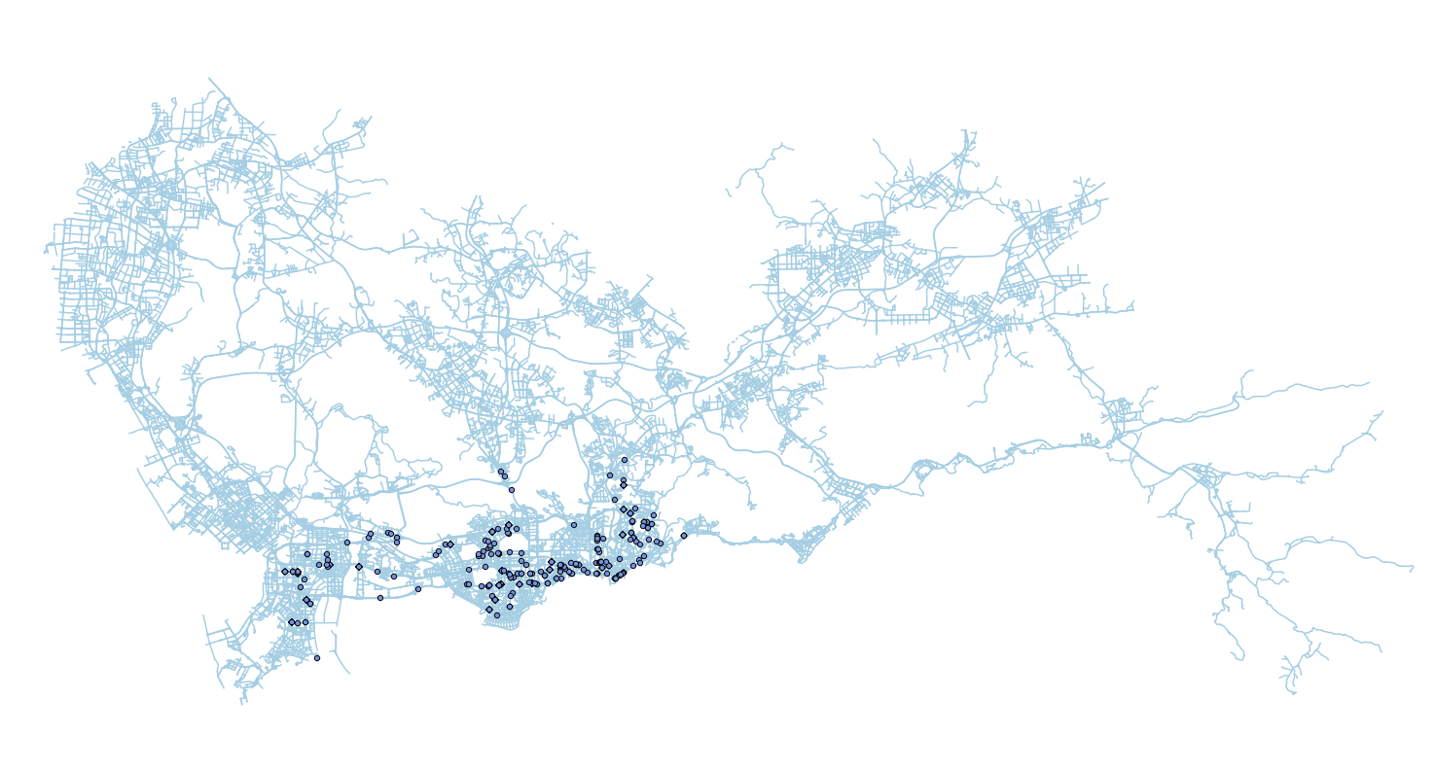
12 – 13 PM

Slide 18
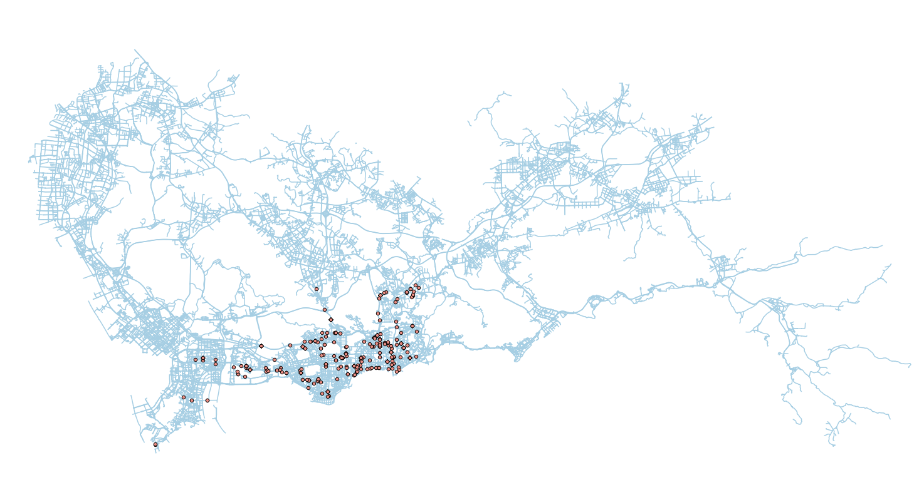
13 – 14 PM

Slide 19
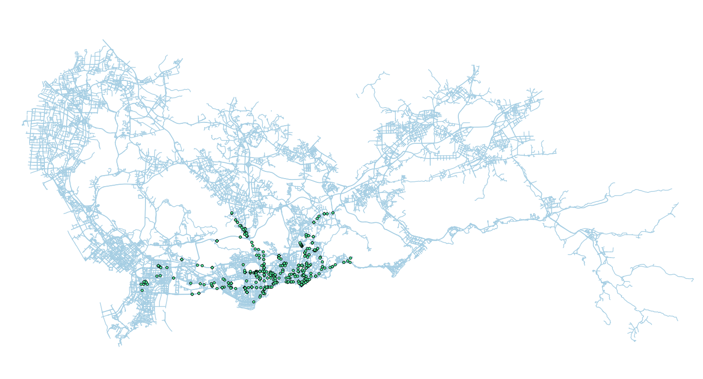
14 – 15 PM

Slide 20
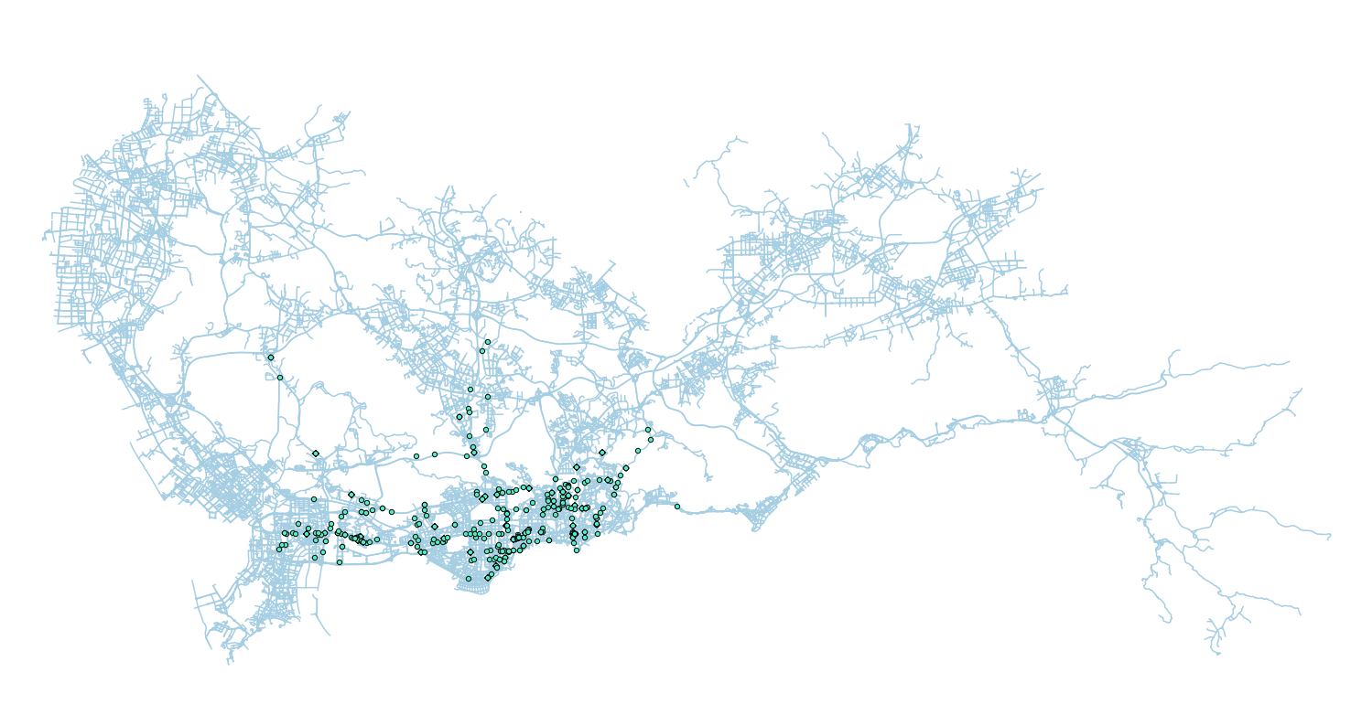
15 – 16 PM

Slide 21
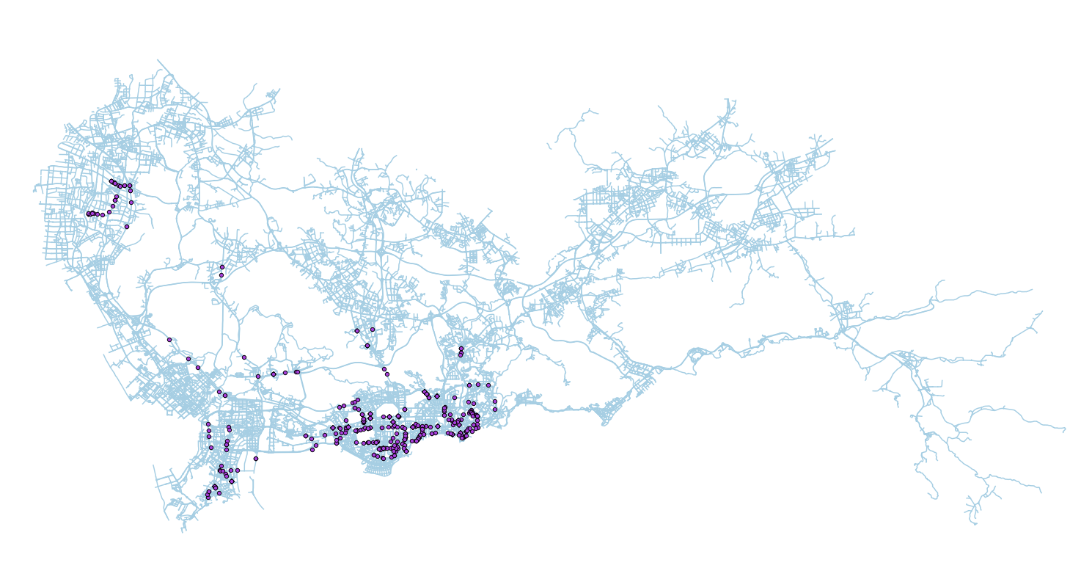
16 – 17 PM

Slide 22
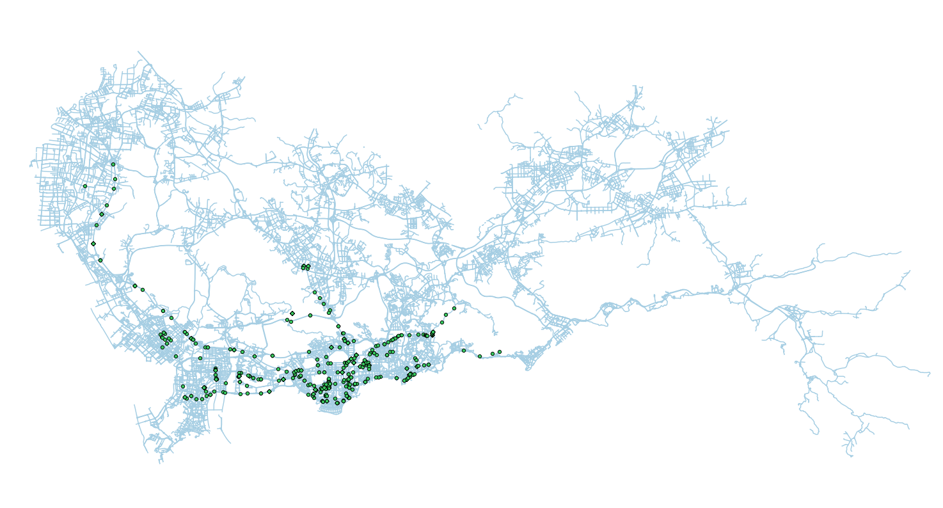
17 – 18 PM

Slide 23
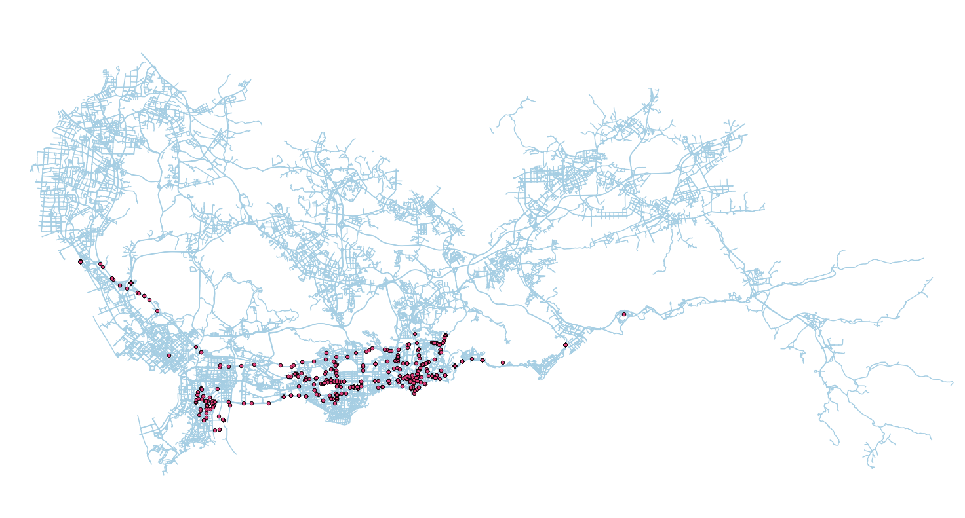
18 – 19 PM

Slide 24

19 – 20 PM

Slide 25
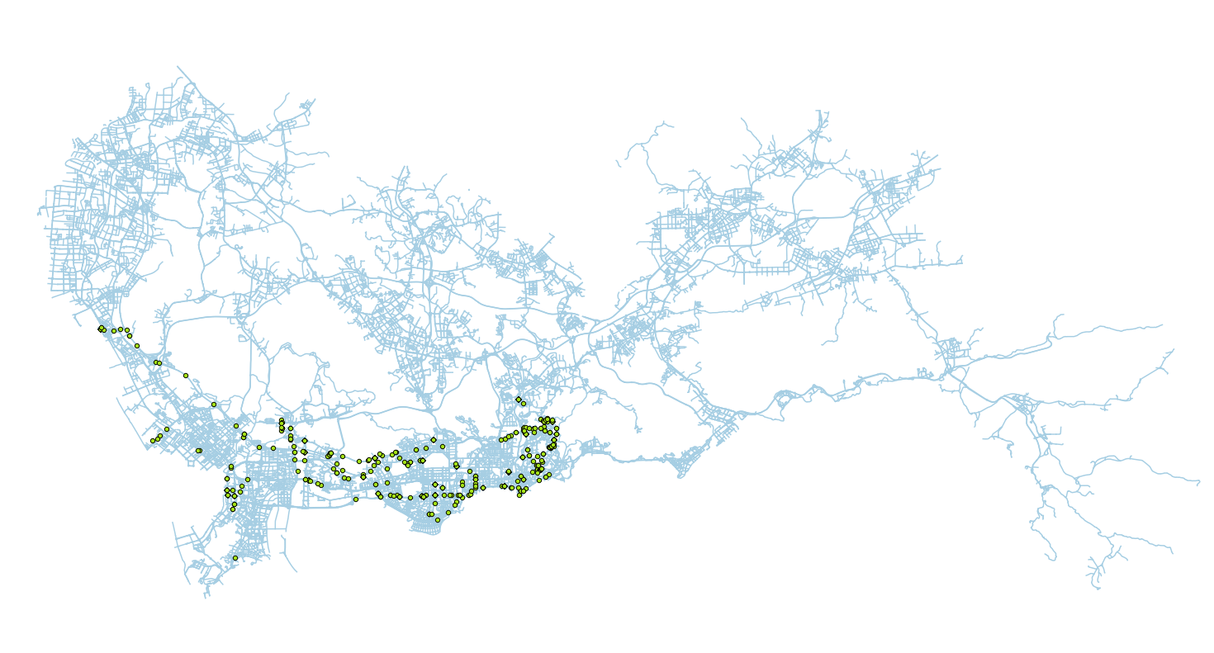
20 – 21 PM

Slide 26
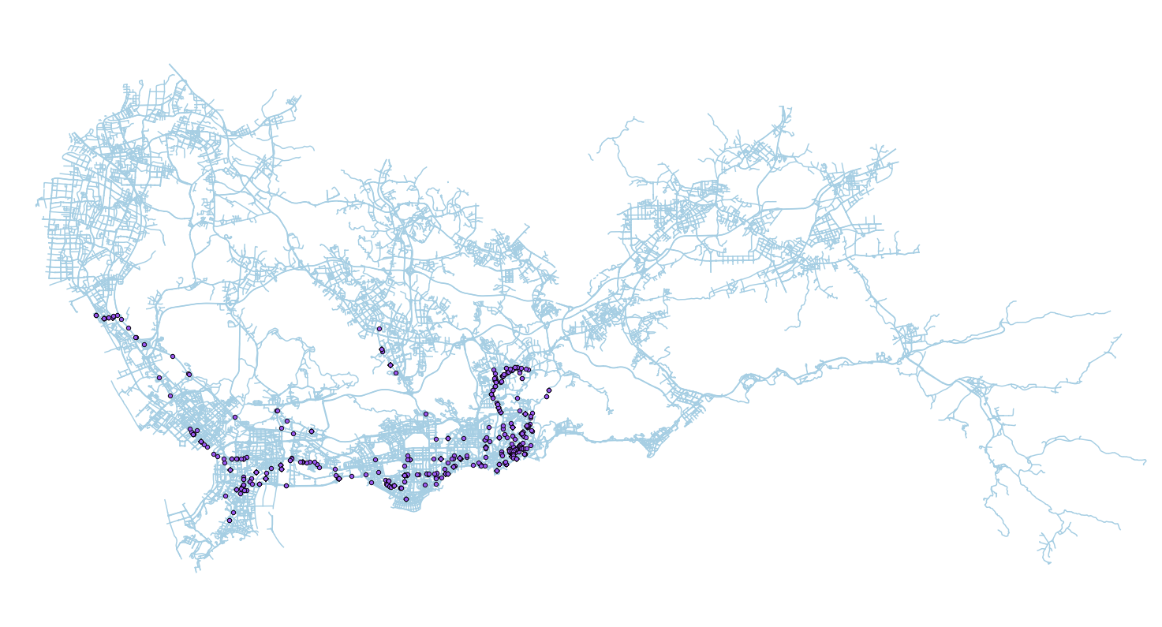
21 – 22 PM

Slide 27

22 – 23 PM

Slide 28
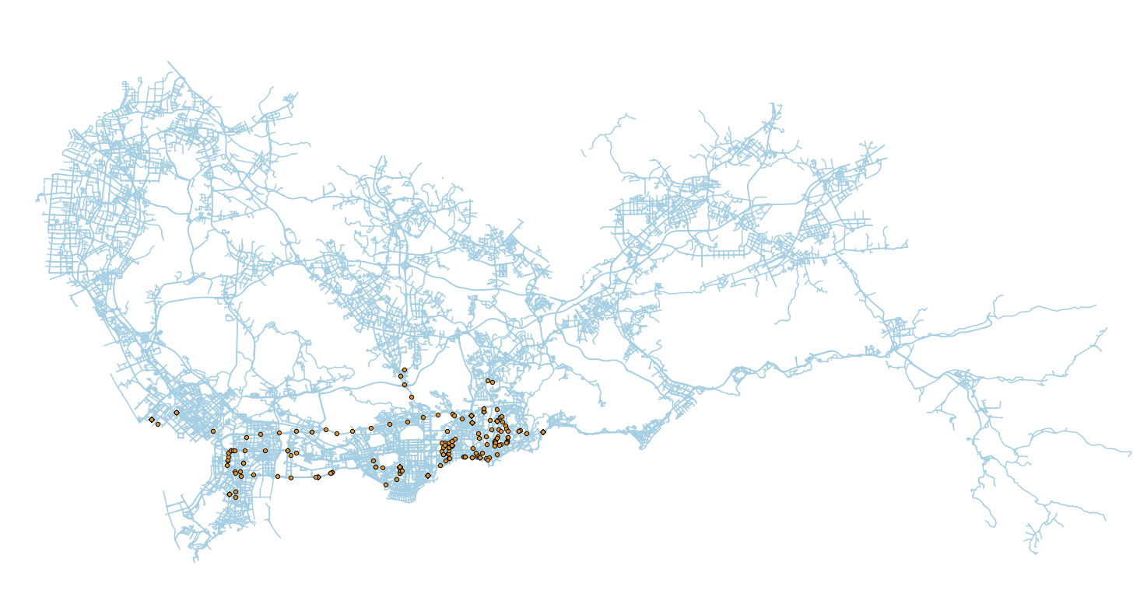
23 – 0 AM

Slide 29
09/08/2009
0 – 1 AM

Slide 30
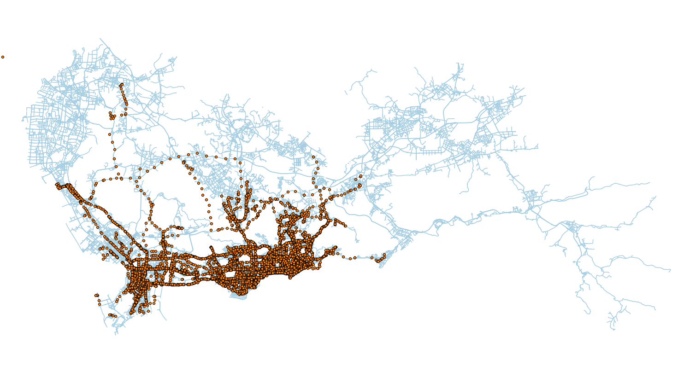
09/11/2009
0 – 1 AM

Slide 31
09/08/2009
1 – 2 AM

Slide 32
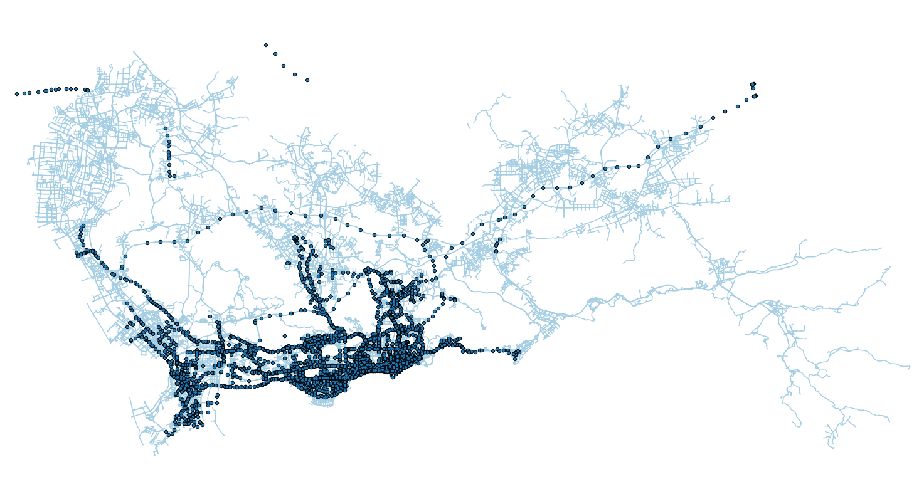
09/11/2009
1 – 2 AM

Slide 33
09/08/2009
2 – 3 AM

Slide 34
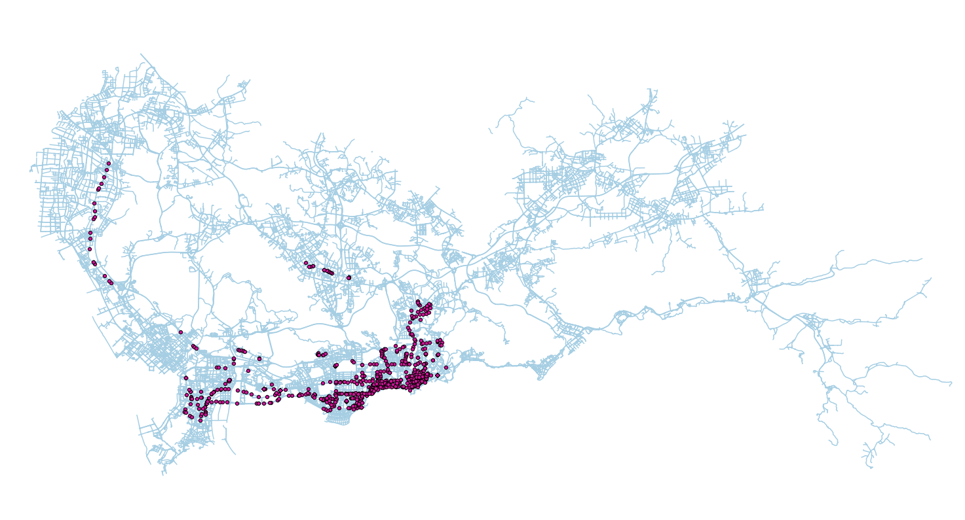
09/11/2009
2 – 3 AM

Slide 35
09/08/2009
3 – 4 AM

Slide 36

09/08/2009
3 – 4 AM

Slide 37
Analysis
Questions
Where are the golden areas?
How the golden area varies hour by hour?
Business Value
Understand demand by area
Understand demand by area by time

Slide 39
Golden Area
Map segmentation

Slide 40
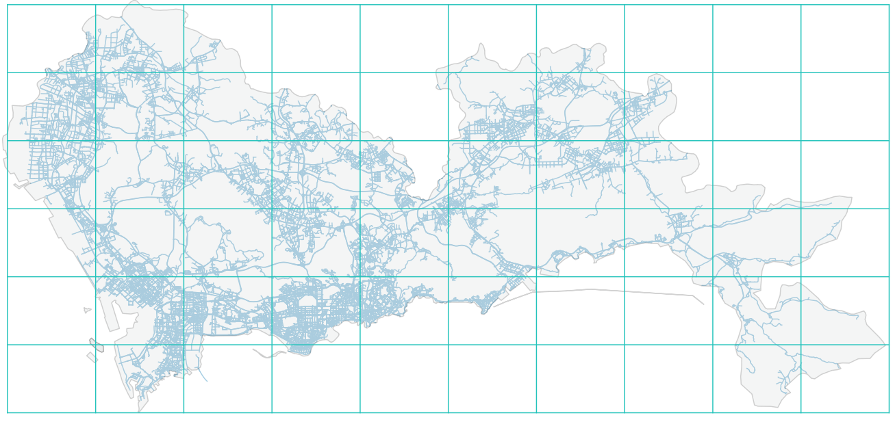
1 2 3 4 5 6 7 8 9 10
11 12 13 14 15 16 17 18 19 20
21 22 23 24 25 26 27 28 29 30
31 32 33 34 35 36 37 38 39 40
41 42 43 44 45 46 47 48 49 50
51 52 53 54 55 56 57 58 59 60

Slide 41
Golden Area
Map segmentation
Find out “Trip” from GPS data

Slide 42
Golden Area – Trip (approximation)
GSP data has a relatively fixed interval
40 s
50 s
80 s
Set threshold of 300 s to separate trips
First point as start, last point as end

Slide 43
Golden Area
Map segmentation
Find out “Trip” from GPS data
Social graph - Adjacent matrix

Slide 44
Golden Area – Directed Graph
2
3
1
6
5
4

Slide 45
Golden Area – Directed Graph
 |  | End
 |  | 1 | 2 | 3 | 4 | 5 | 6
Start | 1 | 0 | 10 | 0 | 0 | 6 | 0
 | 2 | 0 | 0 | 0 | 0 | 0 | 0
 | 3 | 0 | 0 | 0 | 4 | 0 | 0
 | 4 | 0 | 0 | 0 | 20 | 0 | 0
 | 5 | 7 | 0 | 8 | 2 | 0 | 0
 | 6 | 0 | 0 | 0 | 0 | 0 | 0

Slide 46
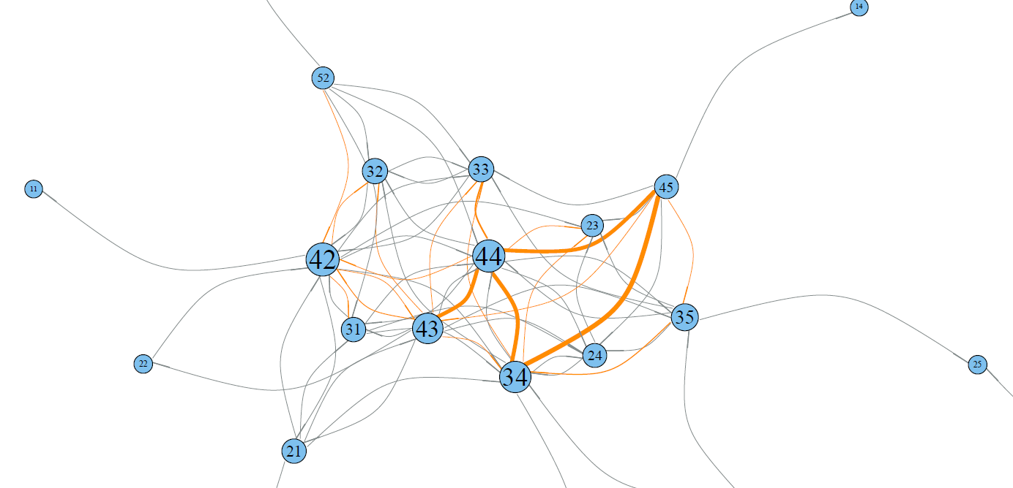
Taxi Trip Graph
Golden Area:
44
42
43
34
45

Slide 47
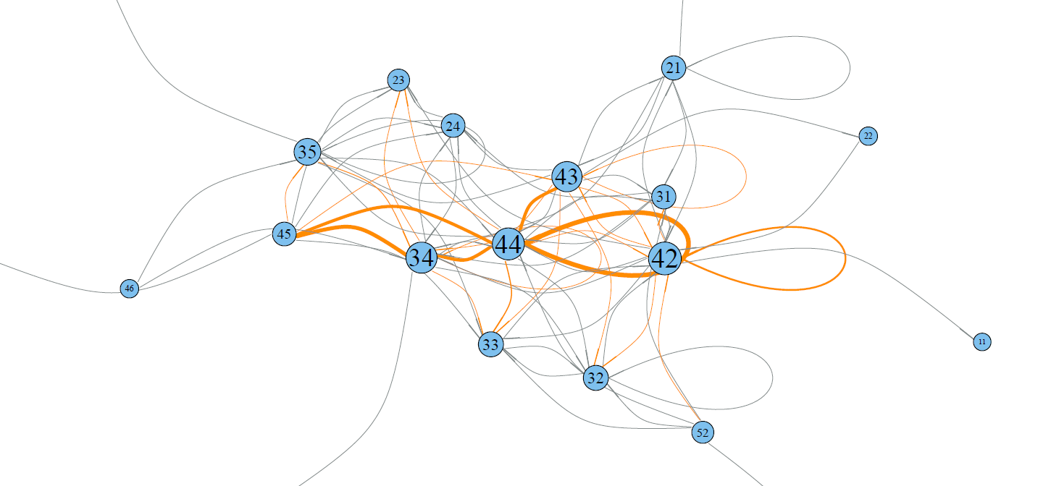
Taxi Trip Graph
Golden Area:
44
42
34
43
35

Slide 48
Taxi Trip Graph
Two Type of Golden Area
Inter-node connection
Loop

Slide 49
1 2 3 4 5 6 7 8 9 10
11 12 13 14 15 16 17 18 19 20
21 22 23 24 25 26 27 28 29 30
31 32 33 34 35 36 37 38 39 40
41 42 43 44 45 46 47 48 49 50
51 52 53 54 55 56 57 58 59 60

Slide 50
Taxi Trip Graph – By Hour
Time Slot | Only Inter-Area | With Loop
0 – 1 AM | 44, 43, 42, 45 | 44, 43, 42, 45
1 – 2 AM | 44, 34, 42, 43 | 44, 34, 43, 42
2 – 3 AM | 44, 43, 42, 34 | 44, 42, 43, 34
Is It Trash?
Limited Data
Area of Focus
Subgroup

Slide 51
Taxi Fare

Slide 52
What’s Next
Focus on dense area
Remove (43, 42, 44) and focus on the rest
Layering
Level 1 – 44, 43, 42, 34
Level 2 – 52, 31, 32
Level 3 – 12, 21

Slide 53
What I learned
Quality of data
No direct connection between taxi fare and trajectory
How to approach
Big data?

Slide 54
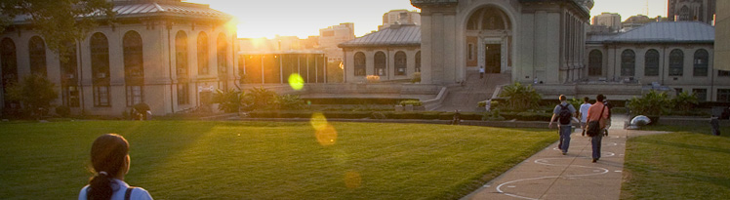
“All models are wrong,
but some are useful”

